Slide 1

English Premier League (EPL)
A134
Team 2
Tejeswara Nehru (U2220197K)
Michael Santoso (U2221525L)
Nguyen Tien Dat (John) (U2220949L)

Slide 2
TABLE OF CONTENTS
01
02
MOTIVATION
EXPLORATORY DATA ANALYSIS
03
04
MACHINE LEARNING
OUTCOMES & INSIGHTS

Slide 3
01
Motivation

Slide 4

Why football?
Football is played by 250 million players in over 200 countries (most popular sport globally).
Sports betting is a 500 billion dollar market (Sydney Herald)

Slide 5


Why this dataset?
The English Premier League (EPL) is the most popular domestic team in the world.
It contains 20 years of EPL matches dataset for predictive analysis

Slide 6

Problem Definition:
We want to investigate the factors which contribute to a team’s performance in terms of winning and losing games and use ML models to predict future matches based on past matches.
Personal Objective:
Predict top 6 teams going into Champions/Europa League

Slide 7
02
EXPLORATORY DATA ANALYSIS

Slide 8





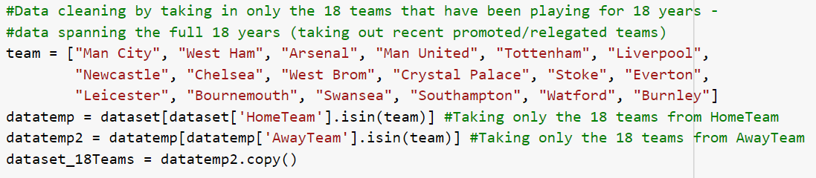
Cleaning
Only keep teams which have been part of the EPL from 2000-2018 (18 in total)

Slide 9
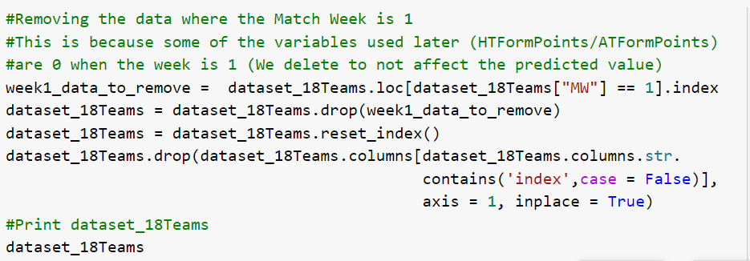
2. Drop the Match Week 1 (NULL values for some variables)

Slide 10
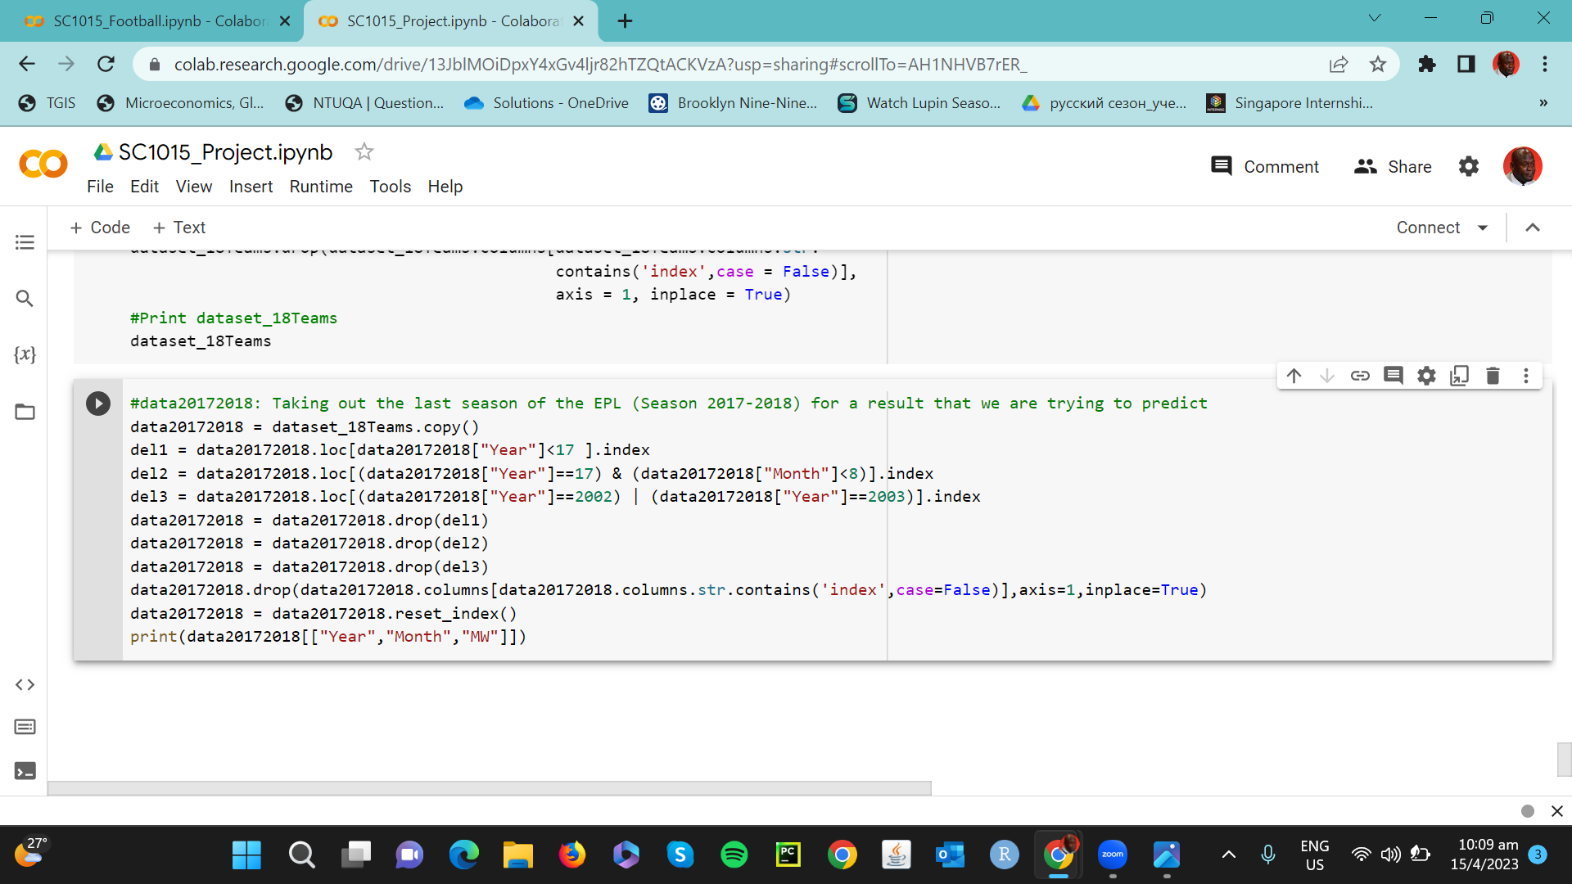
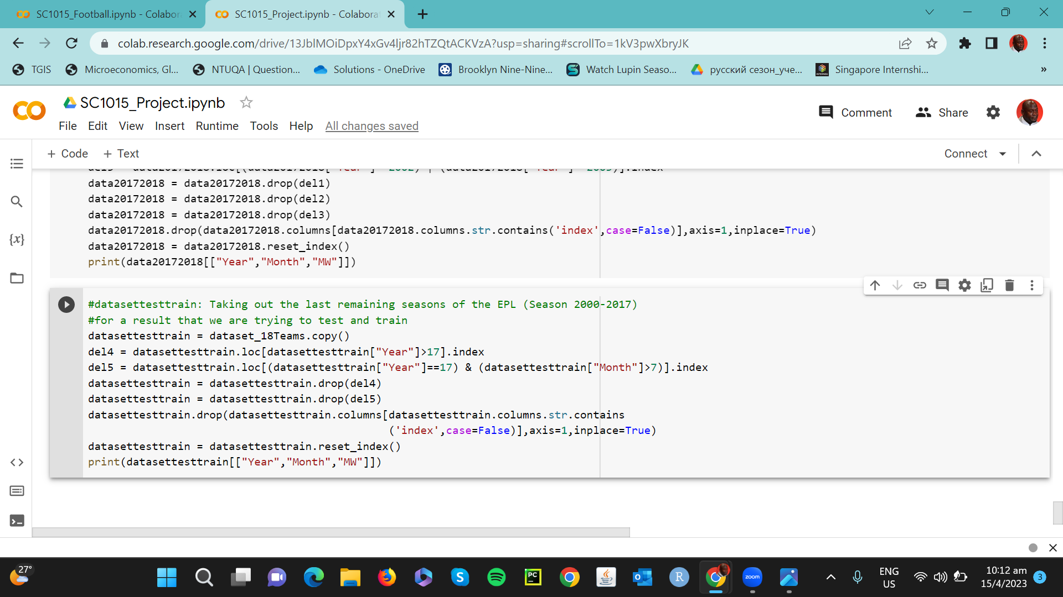
3. Split the dataset into 2 sets (2000-2017 & 2017-2018)

Slide 11
Independent Factors (x-axis)
HTFormPts
ATFormPts
HTGD
ATGD
DiffPts
DiffFormPts
Current season’s tally of points for home team before this match
Current season’s tally of points for away team before this match
Goal Difference i.e Goals scored - Goals conceded for home team
Goal Difference i.e Goals scored - Goals conceded for away team
Difference in Points
Difference in Form Points

Slide 12
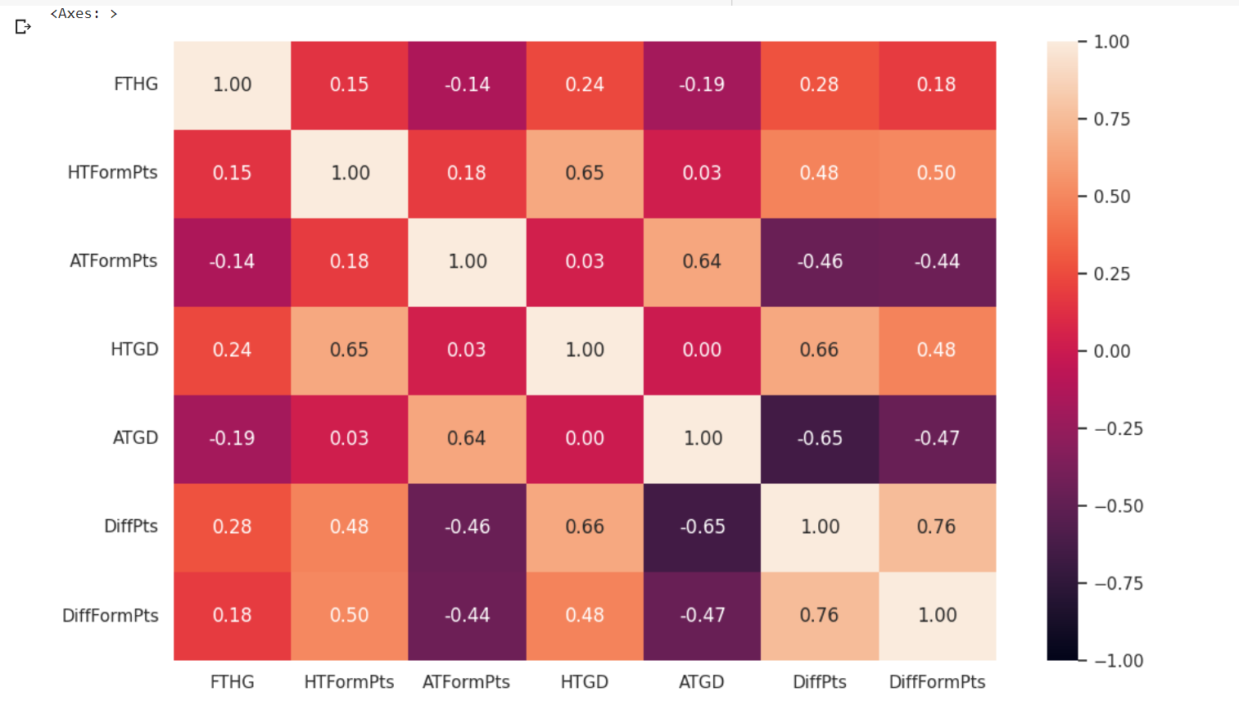
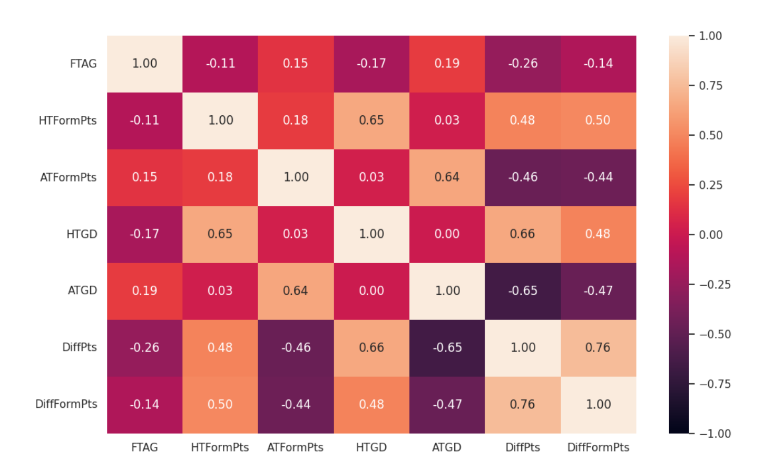
Dependent Factors (y-axis)
FTHG (Full Time Home Goals)
FTAG (Full Time Away Goals)

Slide 13
Exploratory Data Analysis
Calculate the average number of goals scored by each team in home and away matches. Hence, does home advantage play a big factor in match performance?
Determine which teams have the highest and lowest goal differences, and compare this to their overall performance in the league
Analyze how much of an impact a team's form (as indicated by their previous points earned) has on their likelihood of winning a match

Slide 14
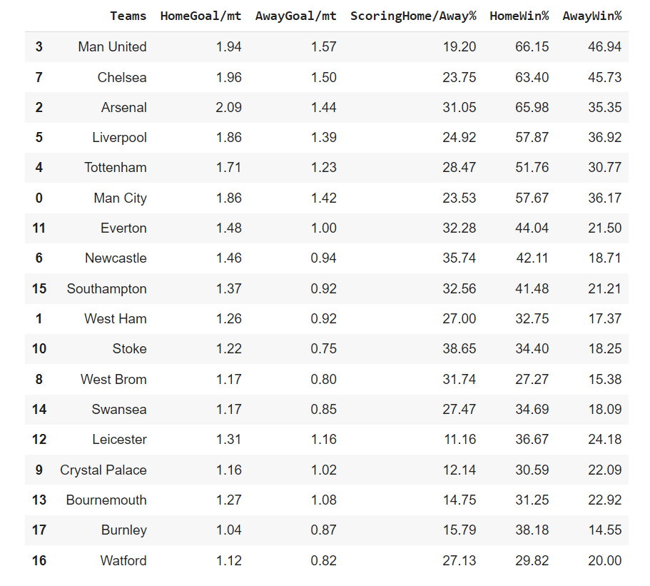
Qn1: Calculate the average number of goals scored by each team in home and away matches. Hence, does home advantage play a big factor in match performance?

Slide 15
Ans1:
Yes. From above stats for all the teams in past 18 years, it is clear that home goals per match is always greater than away goals per match, and we can see a drastic difference between home win% and away win% which describes that all teams perform well on home ground than away grounds.

Slide 16
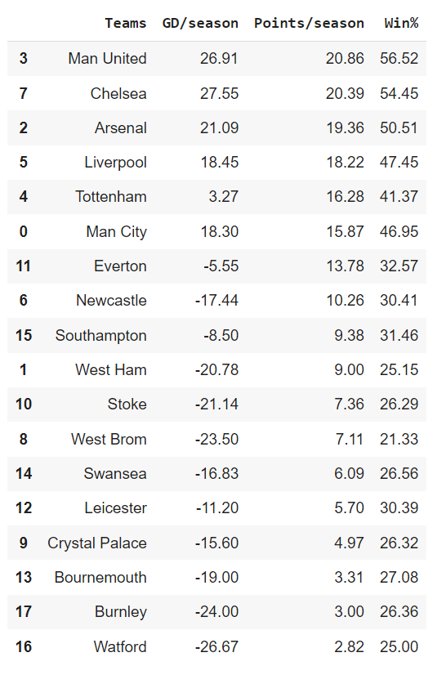
Qn2: Determine which teams have the highest and lowest goal differences, and compare this to their overall performance in the league(entire league & one season)?
General Trend:
GD = (Goal scored - Goal conceded)/Number of Seasons played.
Higher GD leads to higher points/season & win%, better performance.
Exception:
Chelsea has higher GD (27.6) but lower points/season and rank lower than Man United (26.9). Hence, Chelsea with a higher GD performs worse.
Newcastle has lower GD (-17.4) compared to Southampton (-8.5), but it has higher points/season and ranking. Hence, Newstacle with lower GD performs better.
Why exception? Playing style, strength of opponent, goalkeeper performance, luck

Slide 17
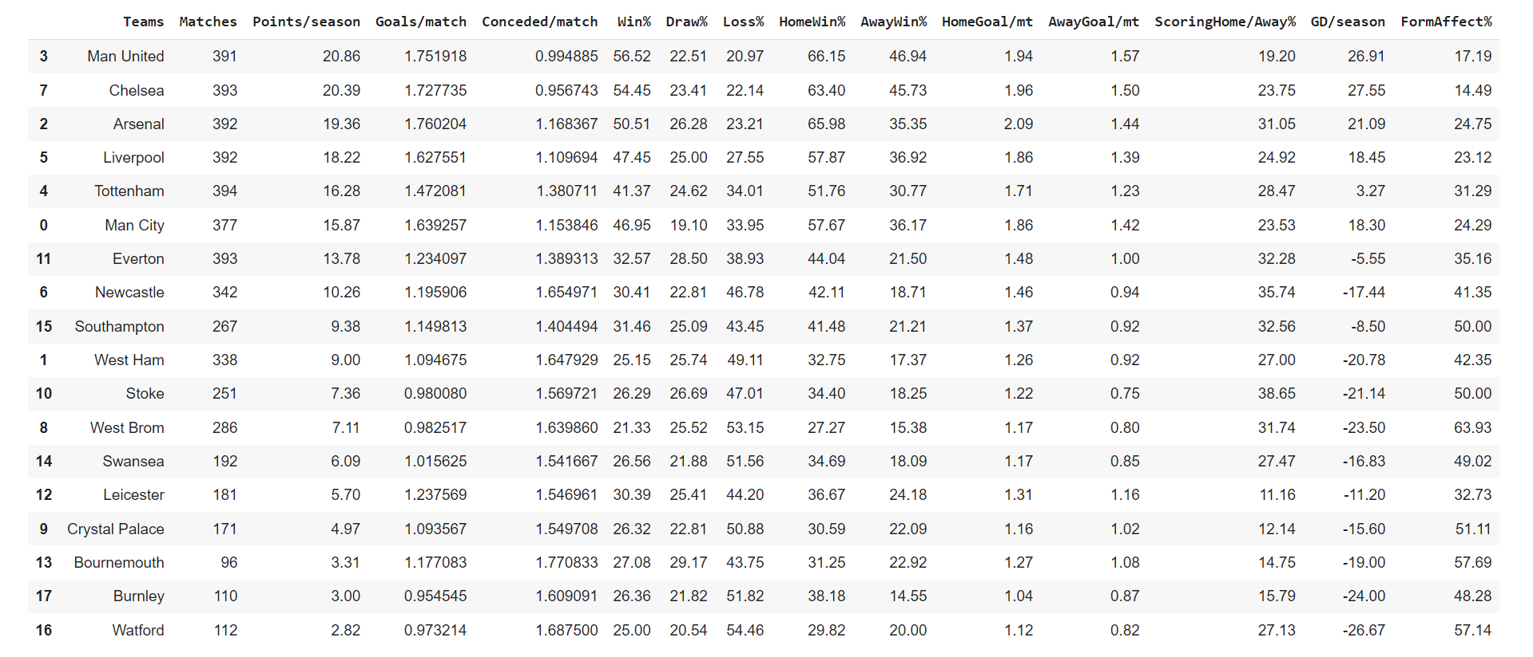
Overall:
Goal Difference gives a fairly good positive correlation to team’s performance (measured by ranking in points/season and Win%).

Slide 18
Qn3: Analyze how much of an impact a team's form (as indicated by their previous points earned) has on their likelihood of winning a match?

Slide 19

Form Points
= (#wins with less form points than opponent) / (total wins)
Ans3:
For most teams: % of matches won by a team with with less form points < 50 %
==

Slide 20




Reasons:
High FormAffect% Teams (relegated/new to EPL)
Low FormAffect% Teams (strong/well-established)

Slide 21
03
MACHINE LEARNING

Slide 22
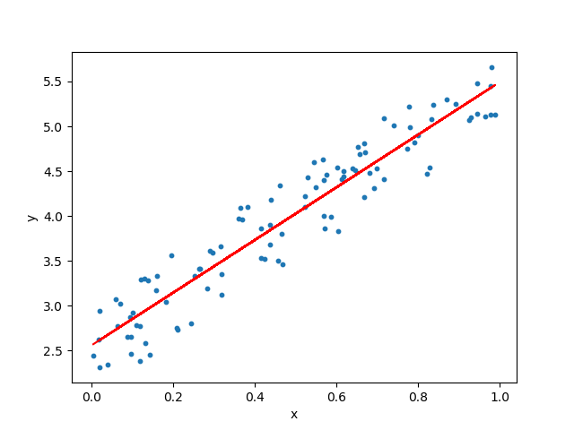

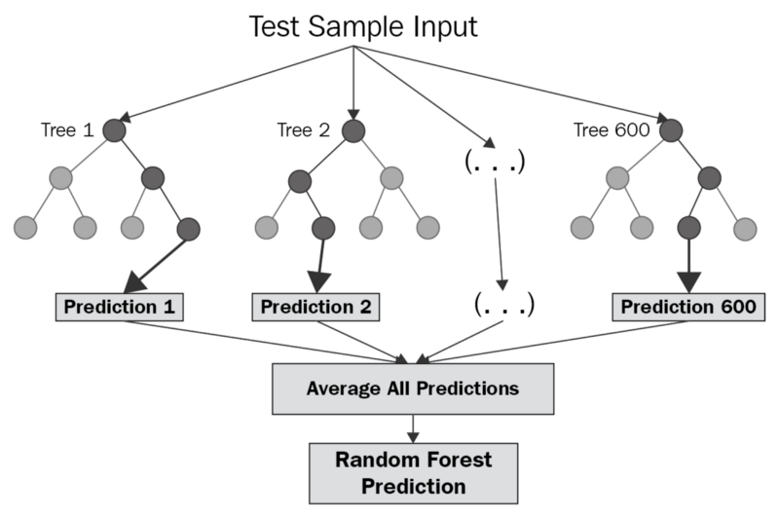
ML Models Used
Linear Regression
Neural Network
Random Forest Regression
Teja
Michael
John

Slide 23
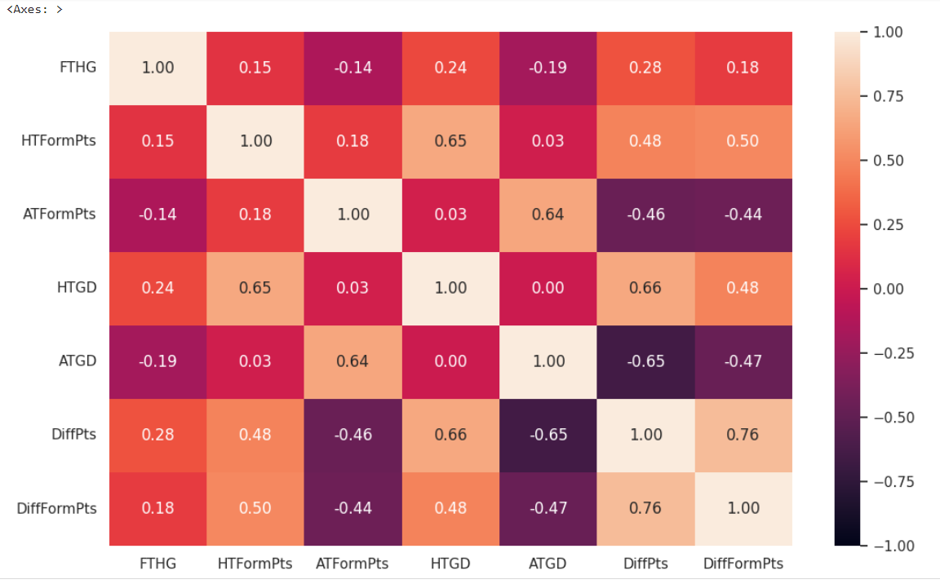
Correlation Matrix (FTHG against factors)

Slide 24
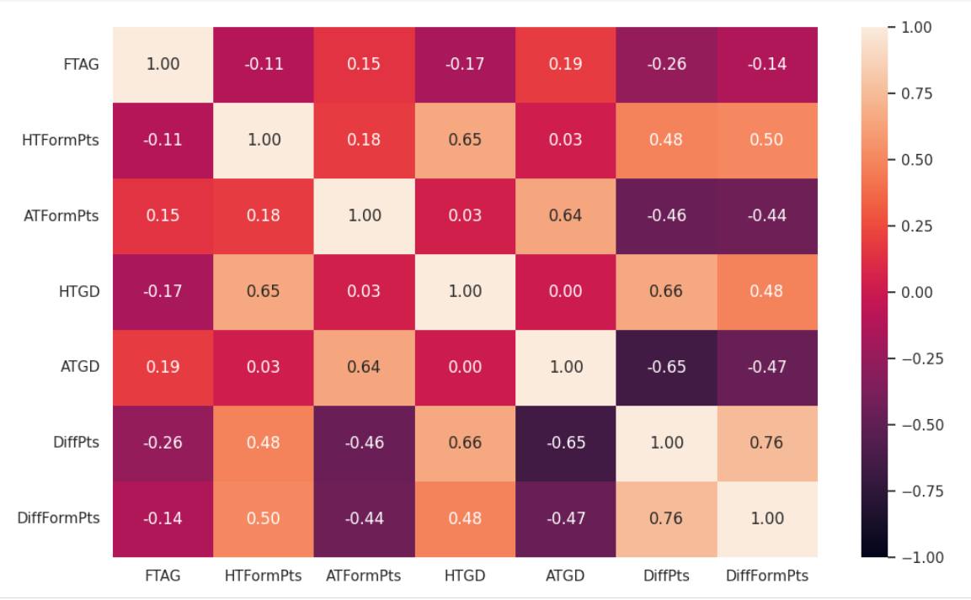
Correlation Matrix (FTAG against factors)

Slide 25
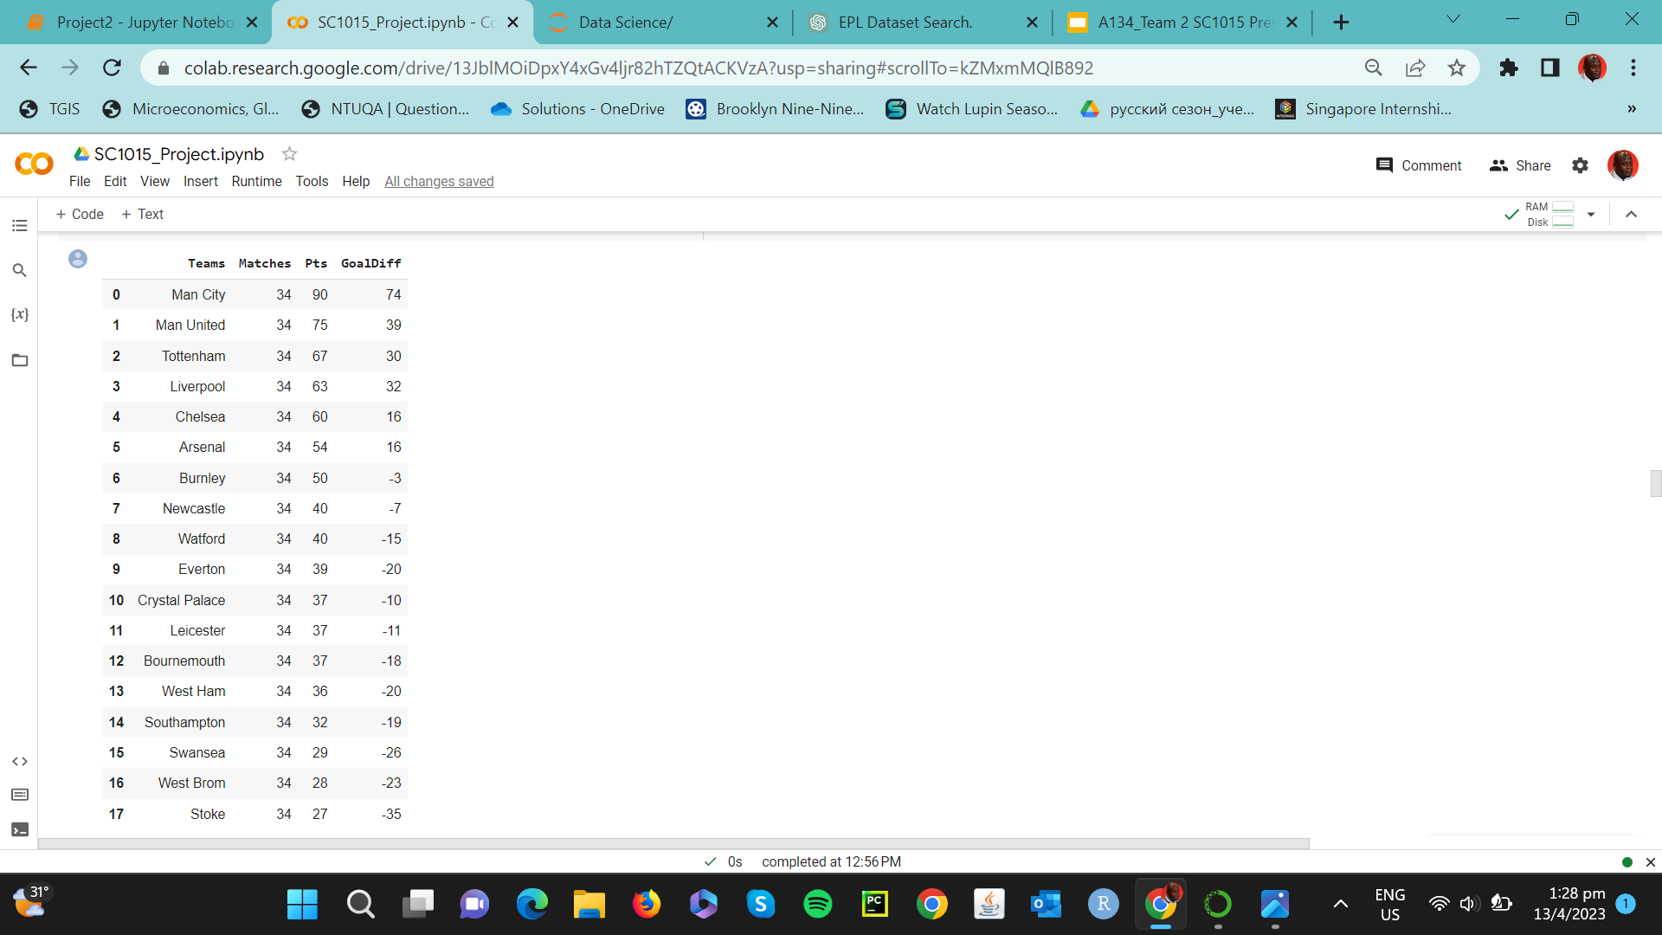
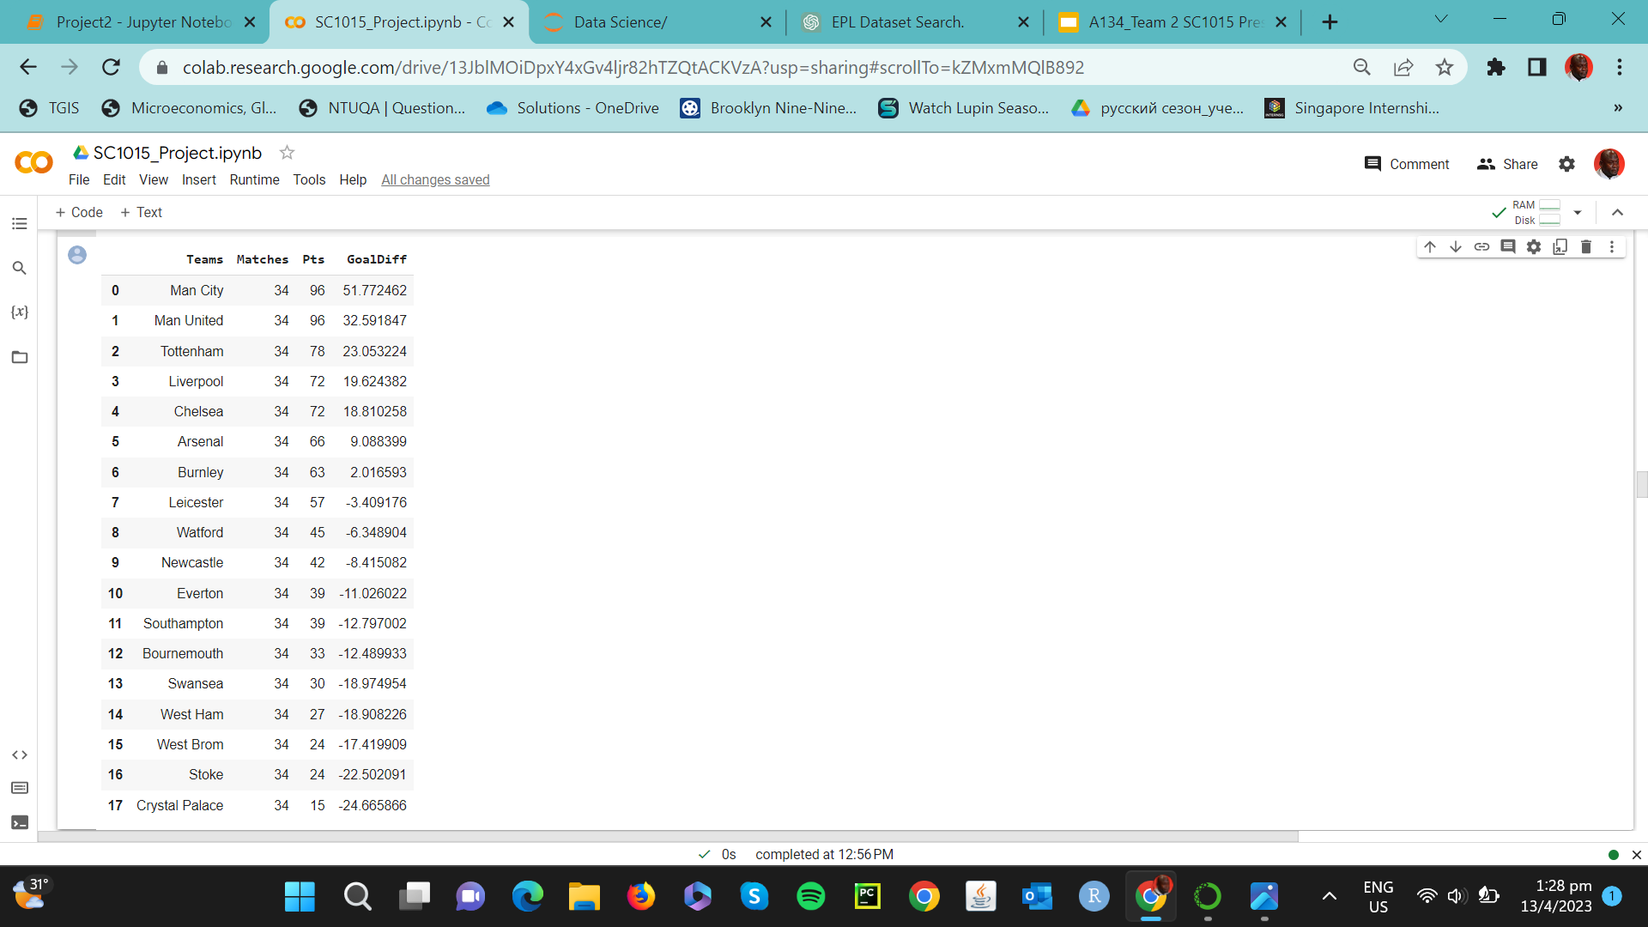
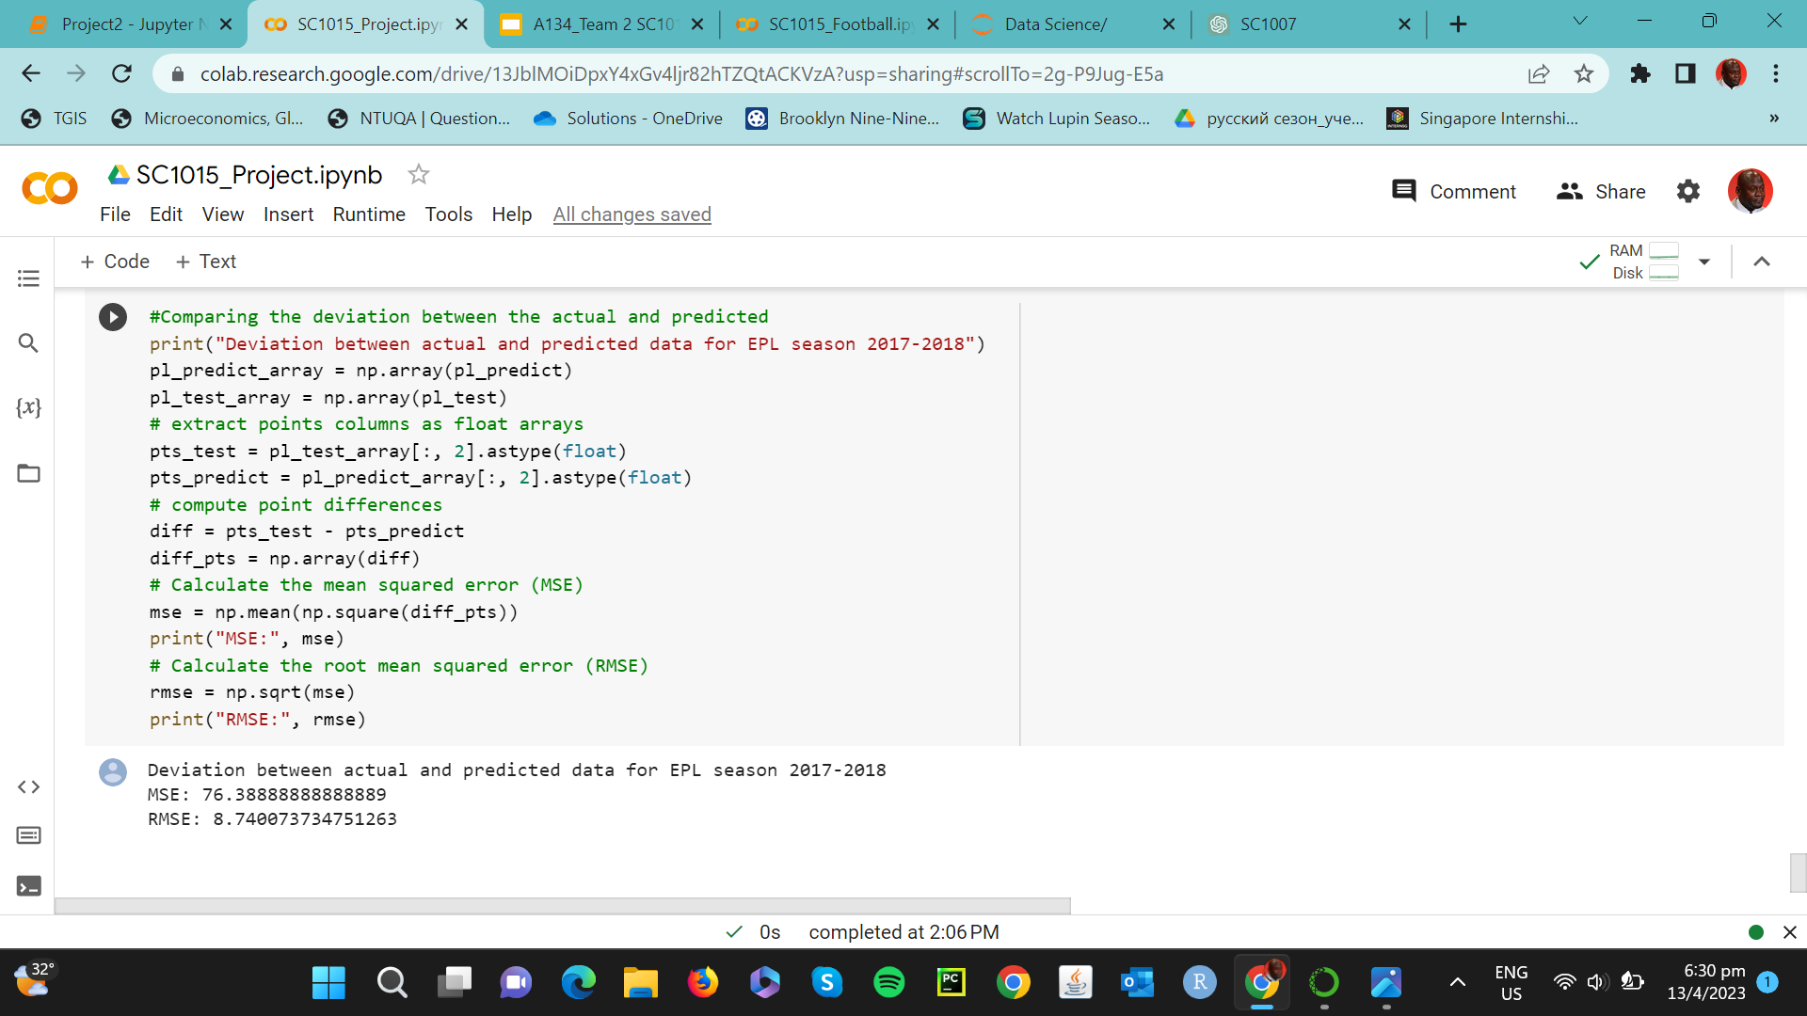
Linear Regression
Results
Actual
Predicted

Slide 26
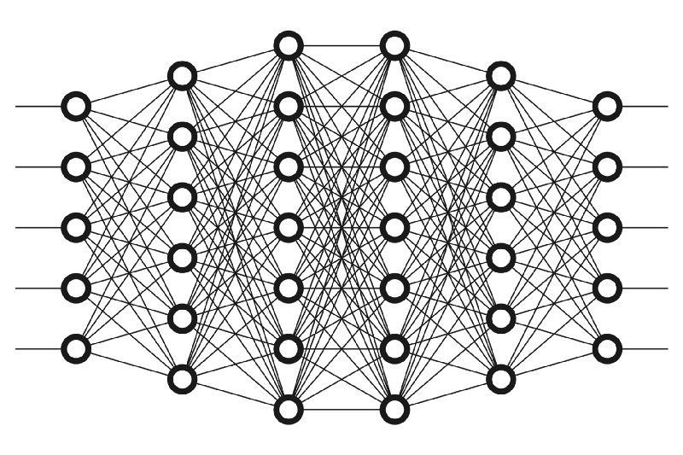
Neural Network
How does neural network work?
Hidden layers
Input layers
Output layers

Slide 27
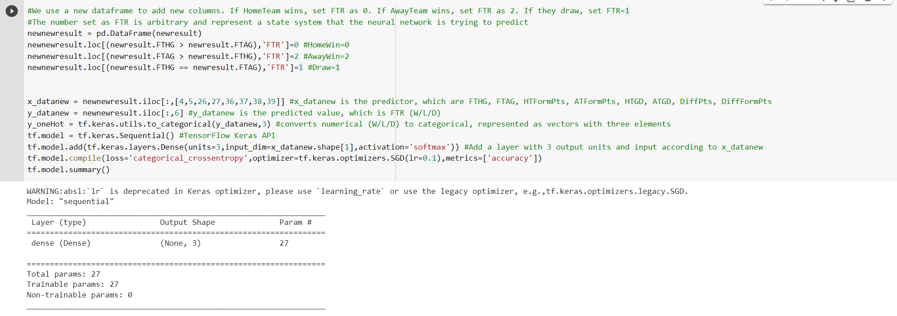
Neural Network
Consider Arsenal vs West Ham (Start with 1vs1 before moving on to the whole EPL)

Slide 28
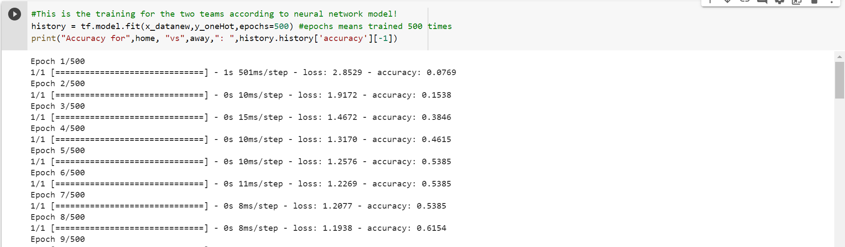
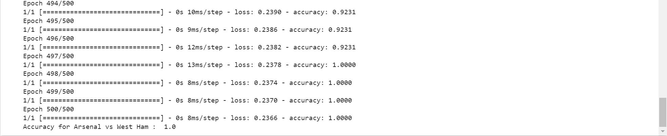
Neural Network
Consider Arsenal vs West Ham (Start with 1vs1 before moving on to the whole EPL)

Slide 29
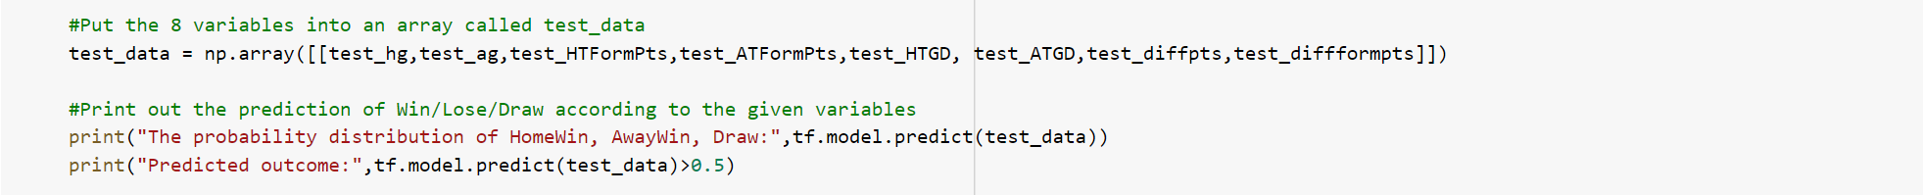
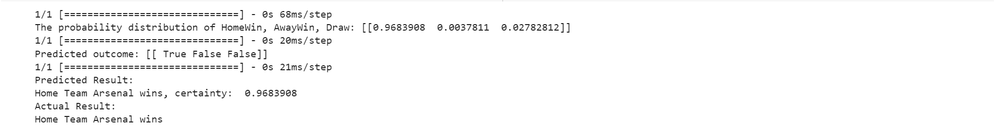

Neural Network
Consider Arsenal vs West Ham (Start with 1vs1 before moving on to the whole EPL)
Replicate this on all the teams: every teams will have a 1vs1 neural network processing to get the result.

Slide 30
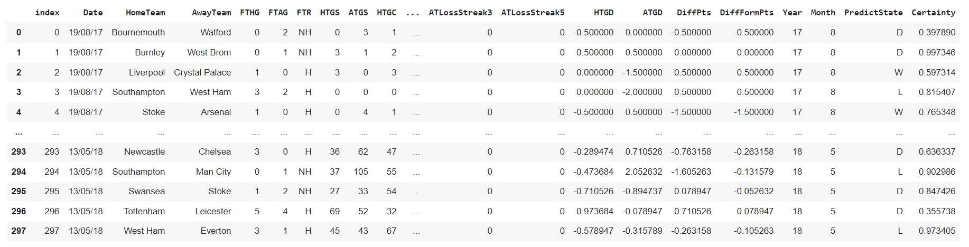
Neural Network Results
Consider every team vs each other. After every computation of 1vs1, the result is:

Slide 31
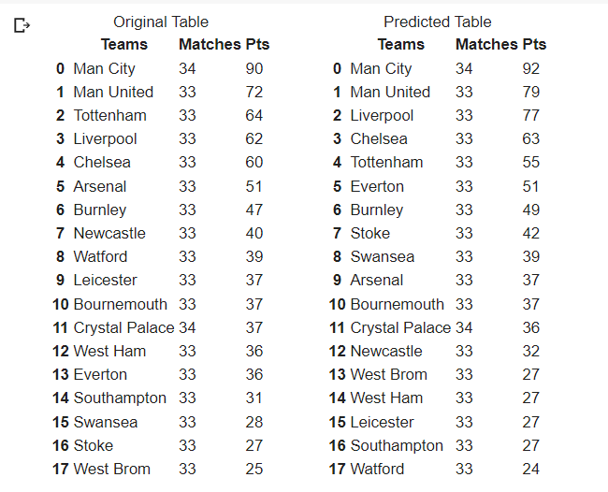
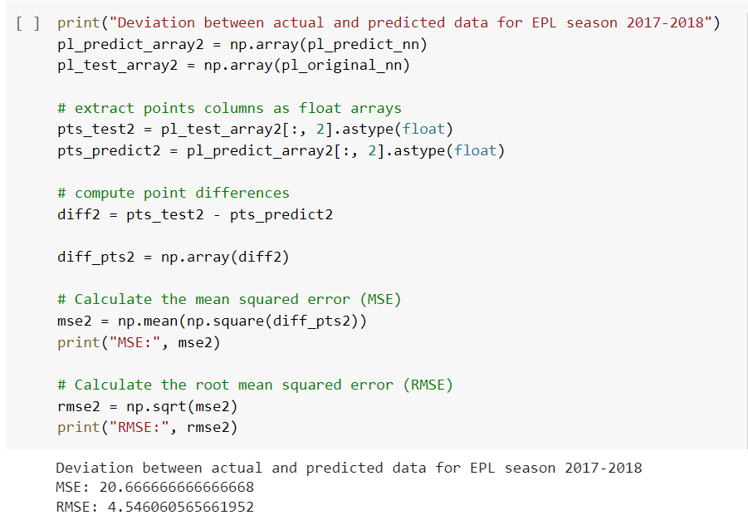
Neural Network Results
Consider every team vs each other. After every computation of 1vs1, the result is:

Slide 32
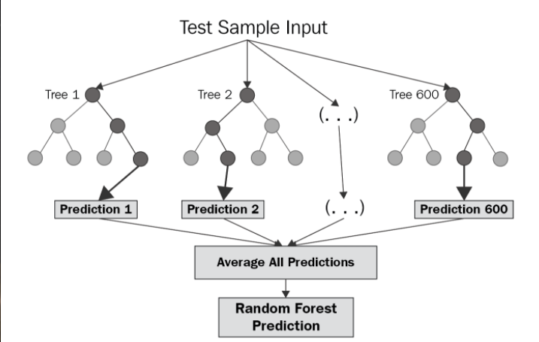
Random Forest Regression

Slide 33
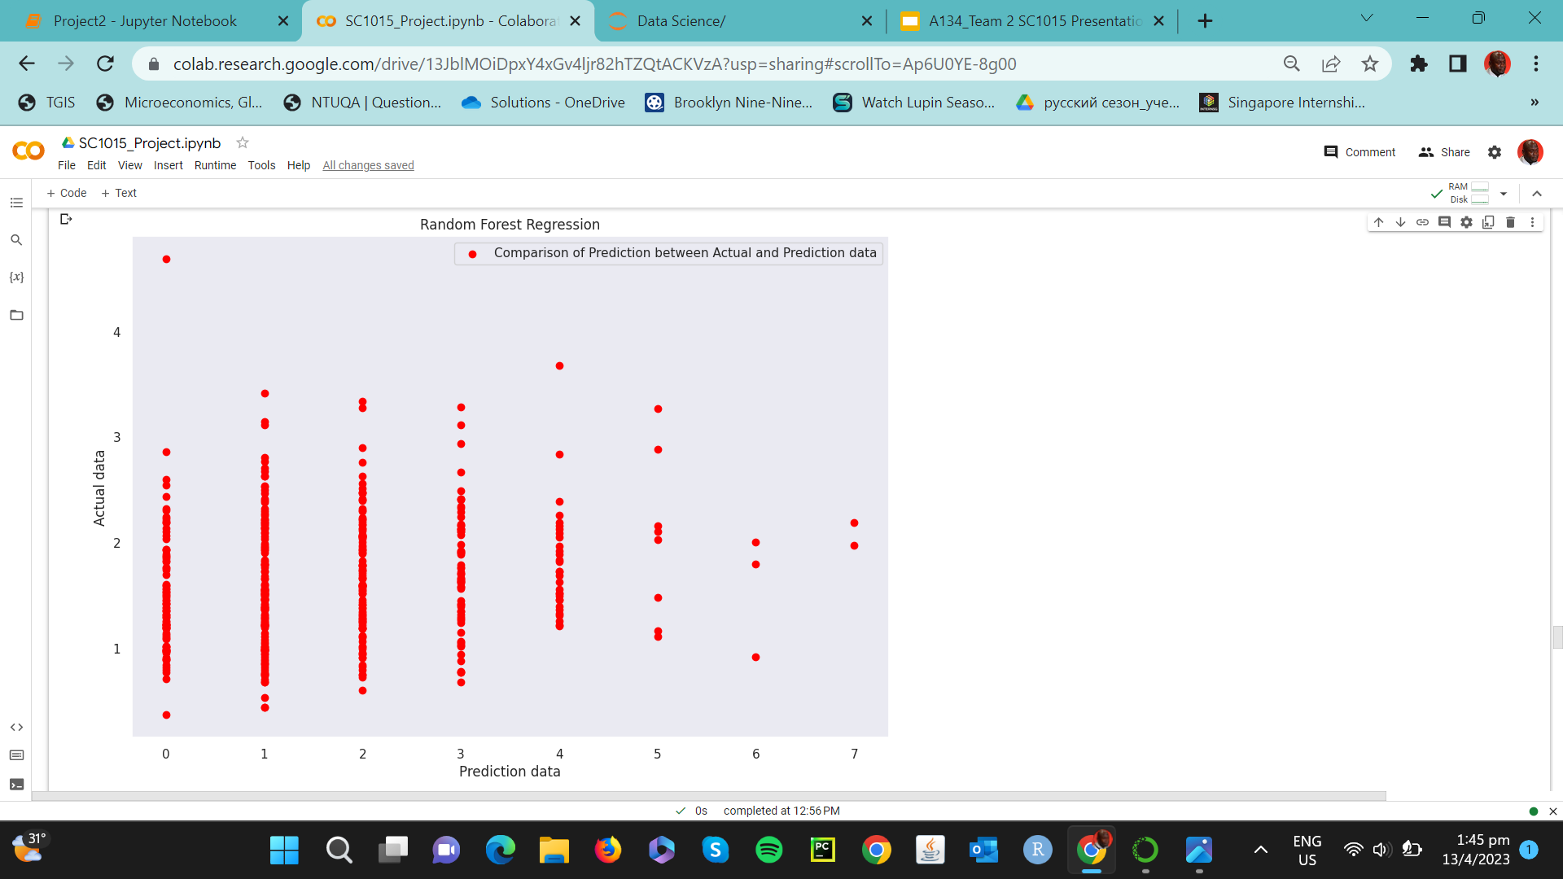
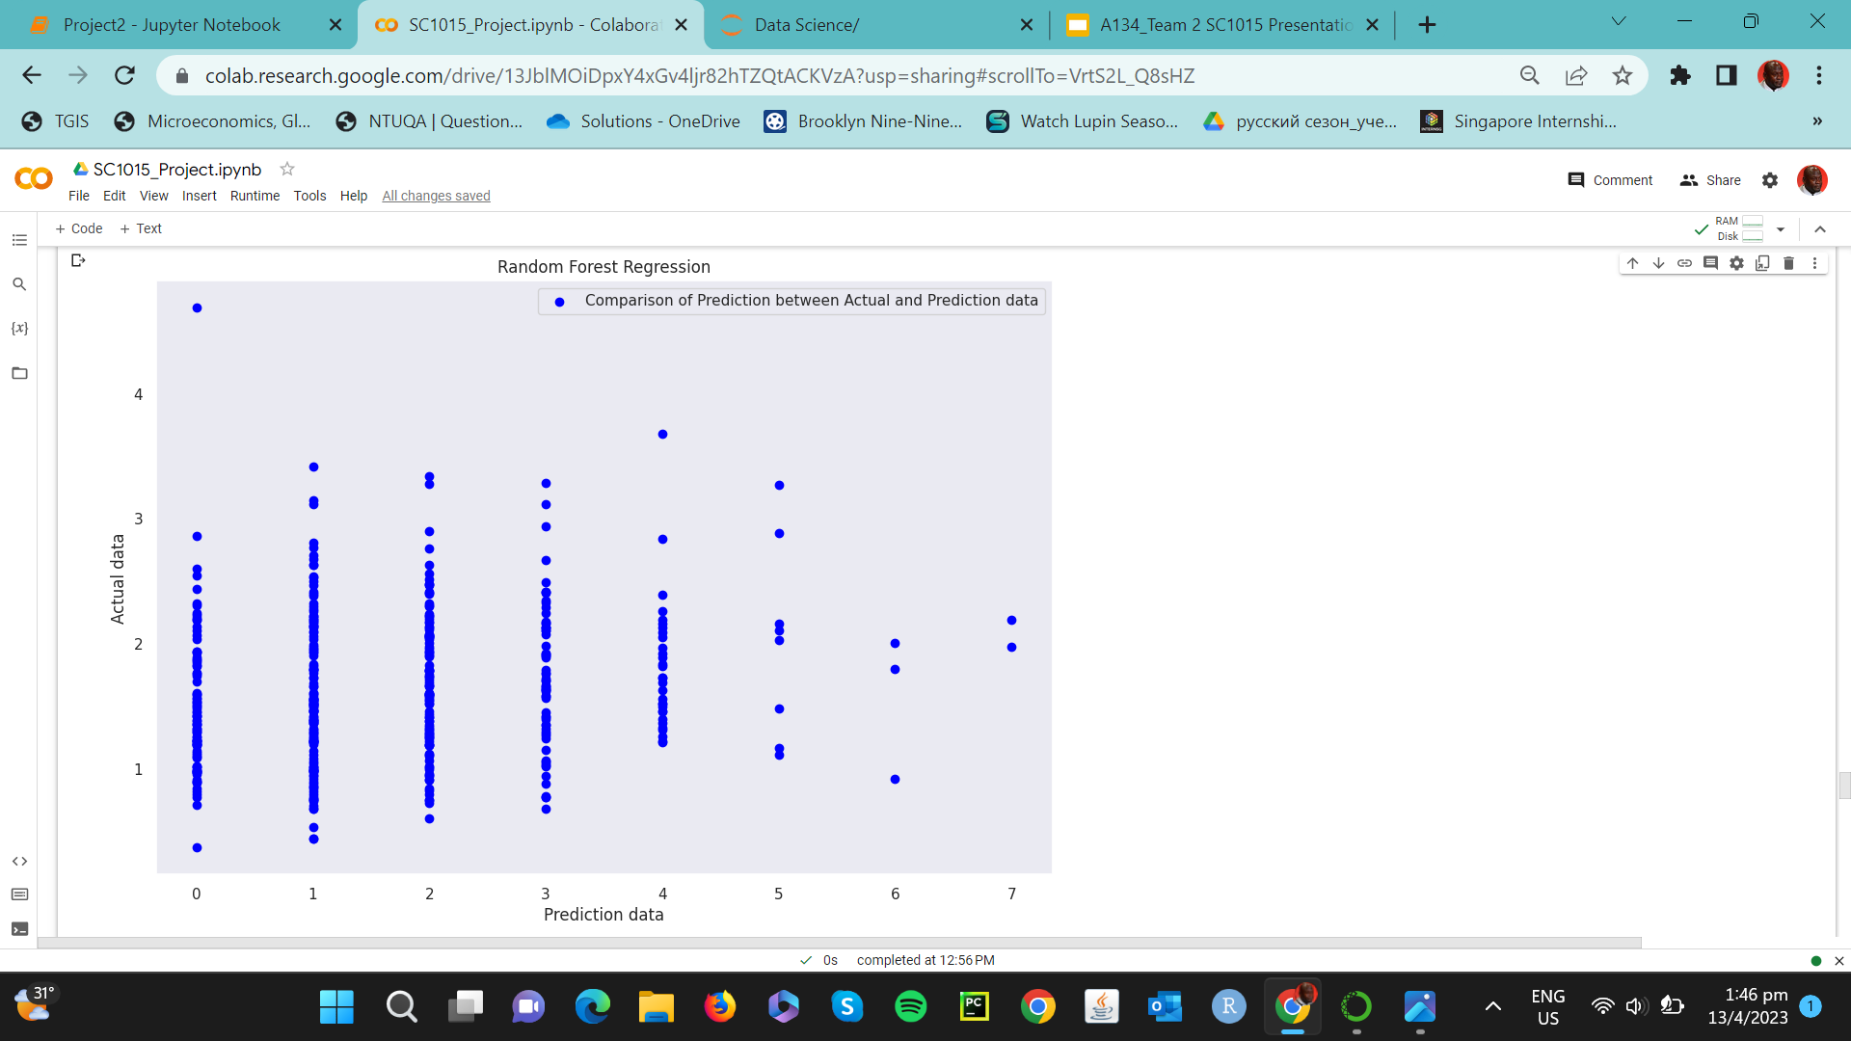
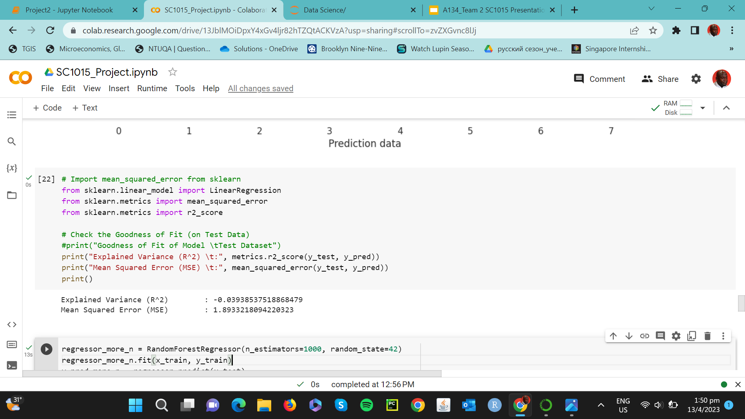
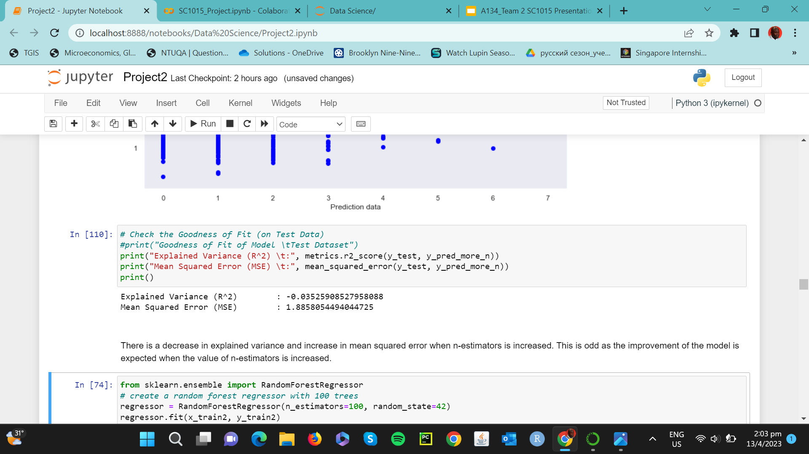

Slide 34


100 Trees
1000 Trees
Explained Variance (R^2)
-0.039385
-0.035259
1.89332
RMSE
1.89332

Slide 35
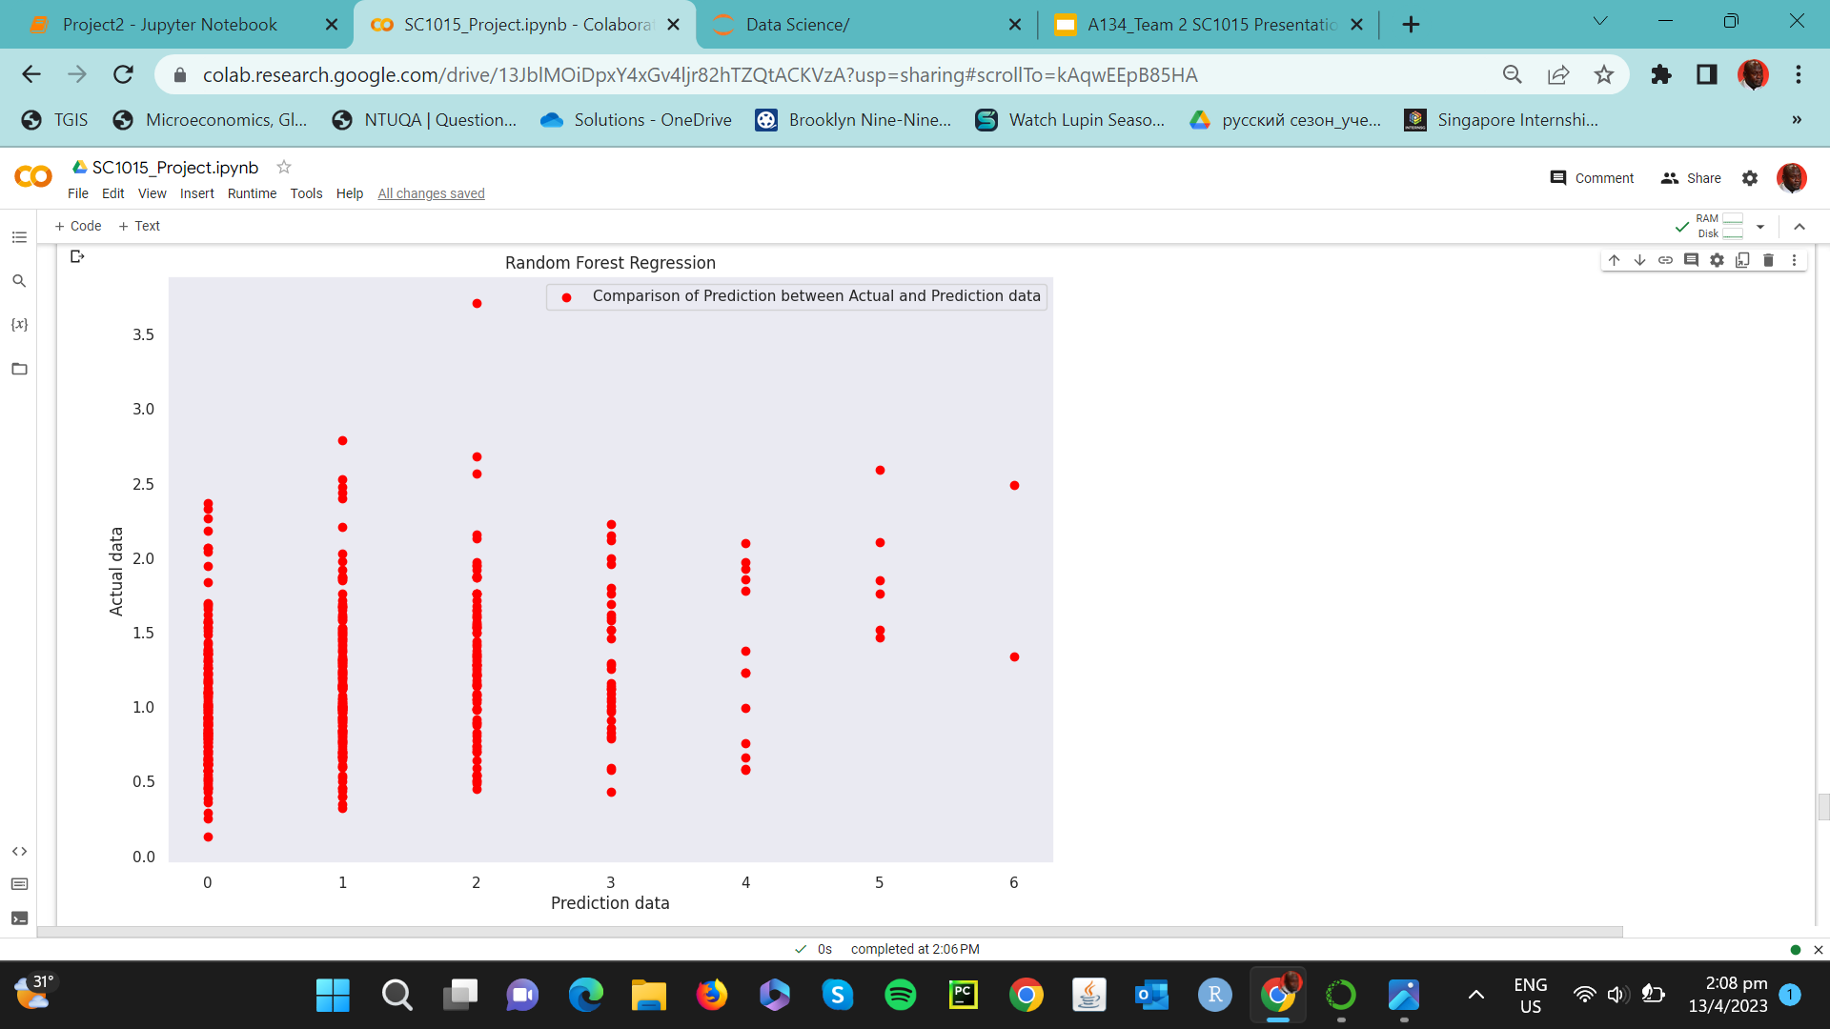
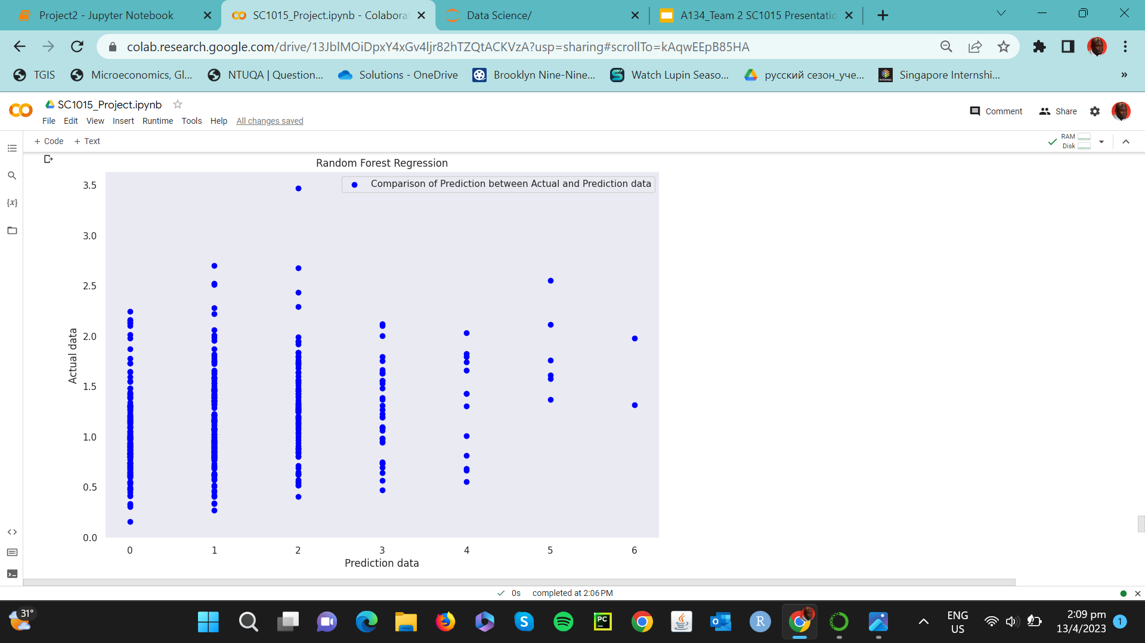
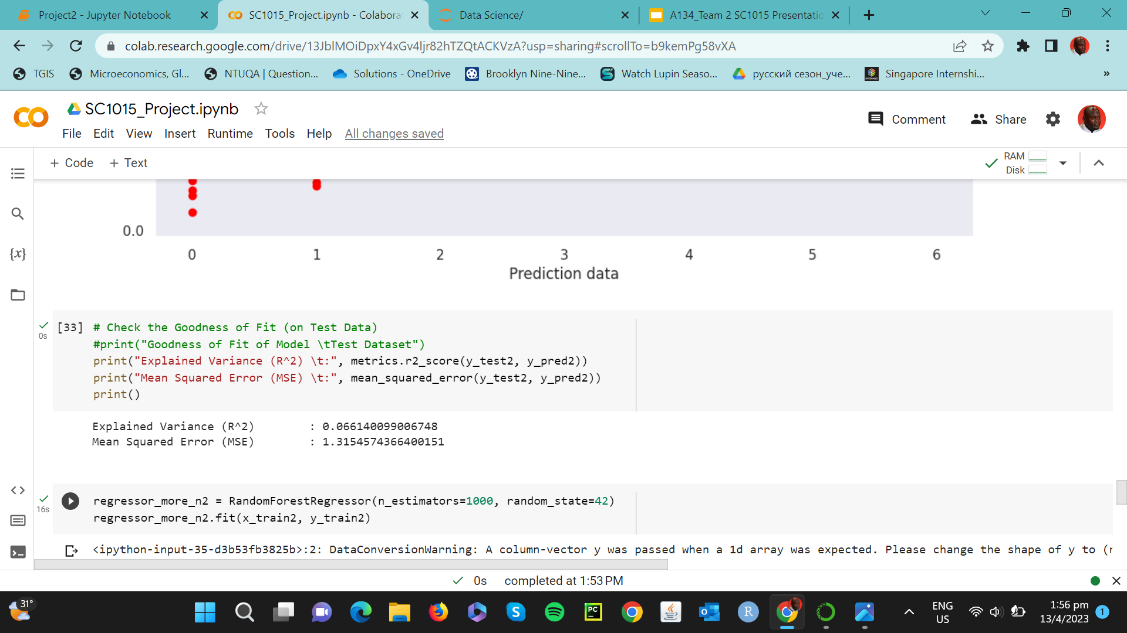
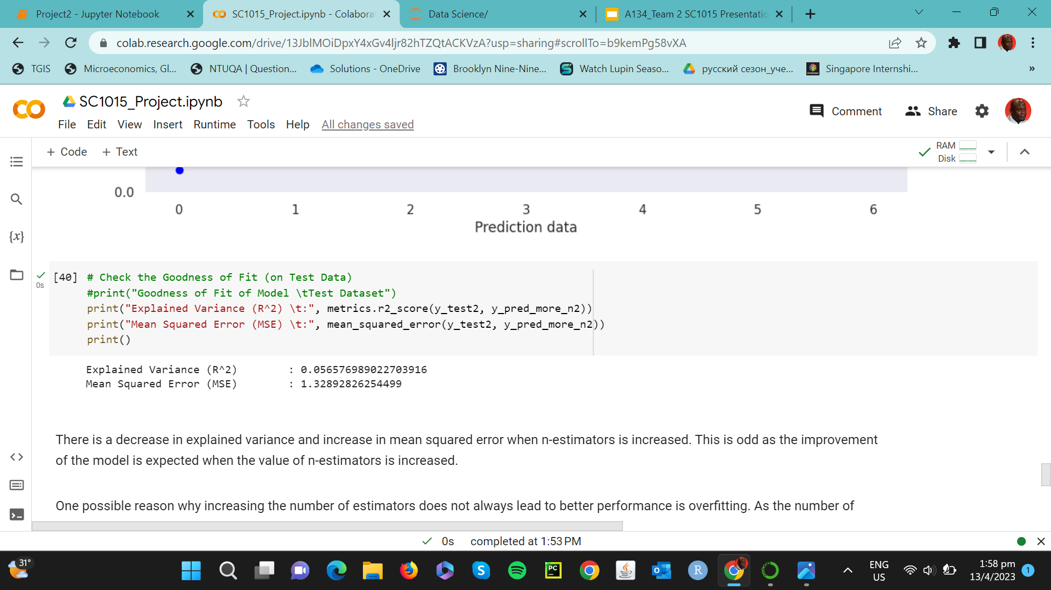

Slide 36
100 Trees
1000 Trees
Explained Variance (R^2)
0.006614
0.005658
1.31546
RMSE
1.32893

Slide 37
Possible Reasons
Overfitting
-Noise in train set
-Performance on test data degrade
Non-linear relationship
-some types of non-linearity non captured

Slide 38
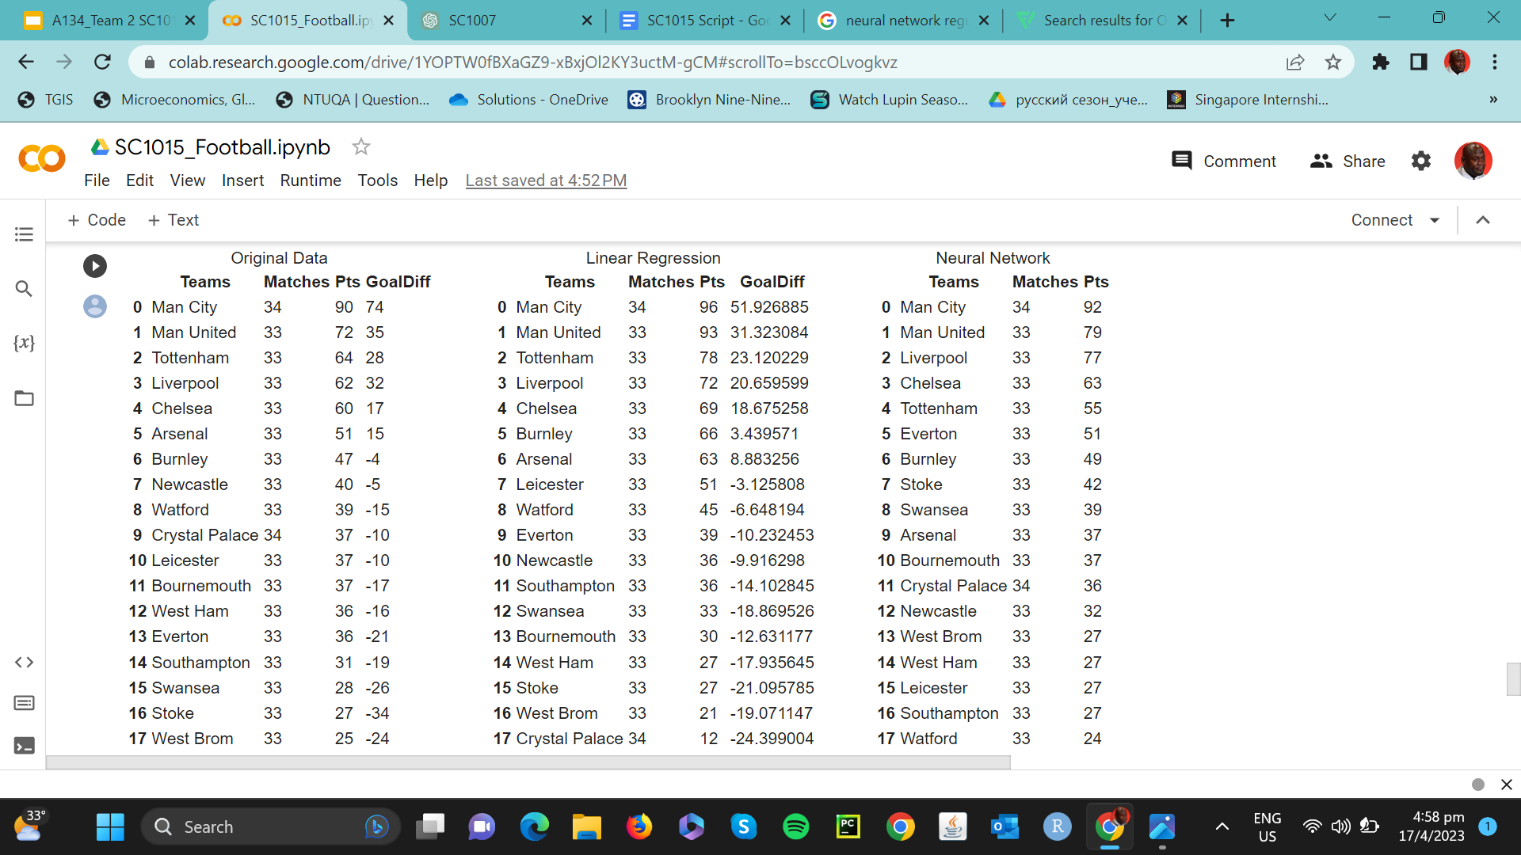
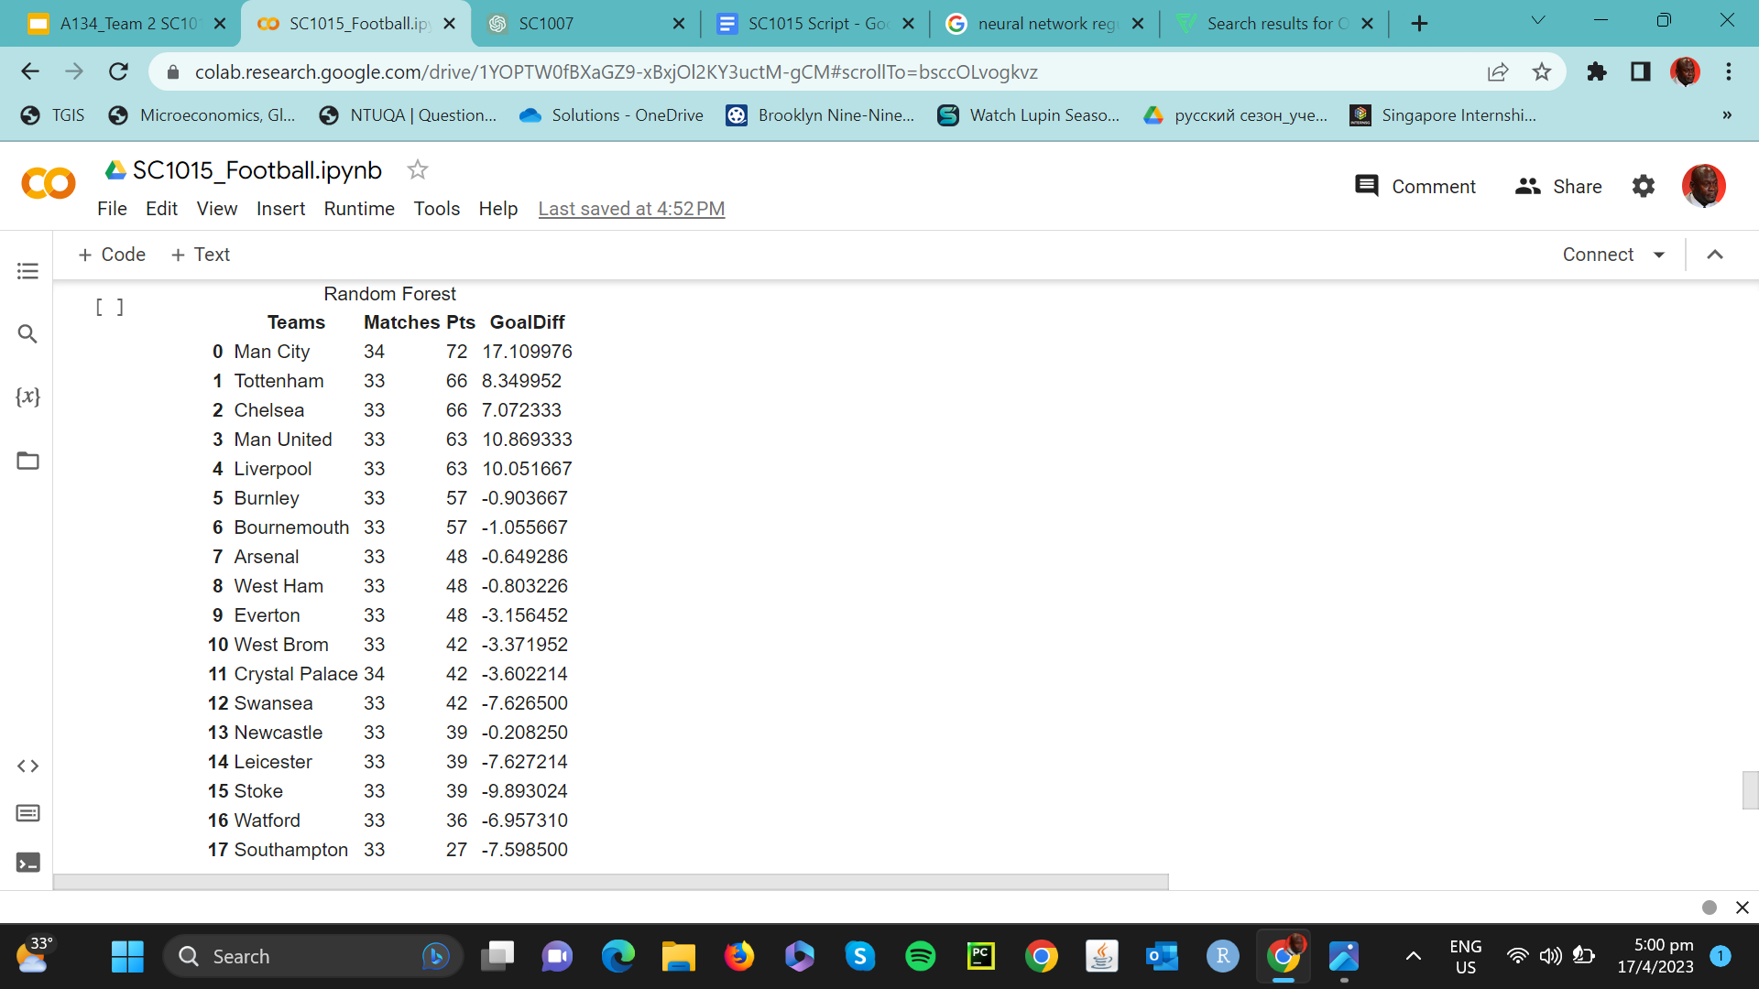
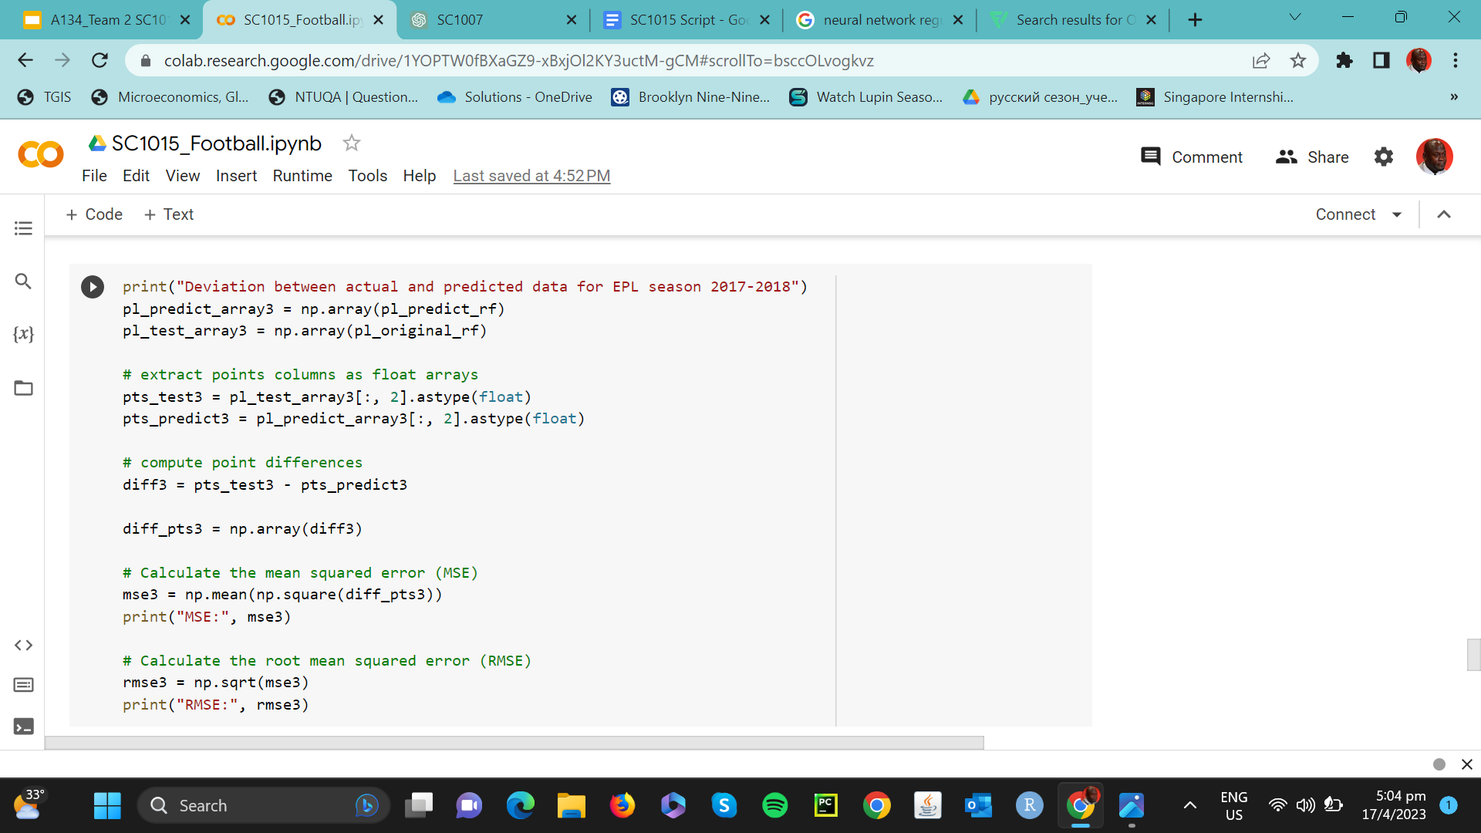
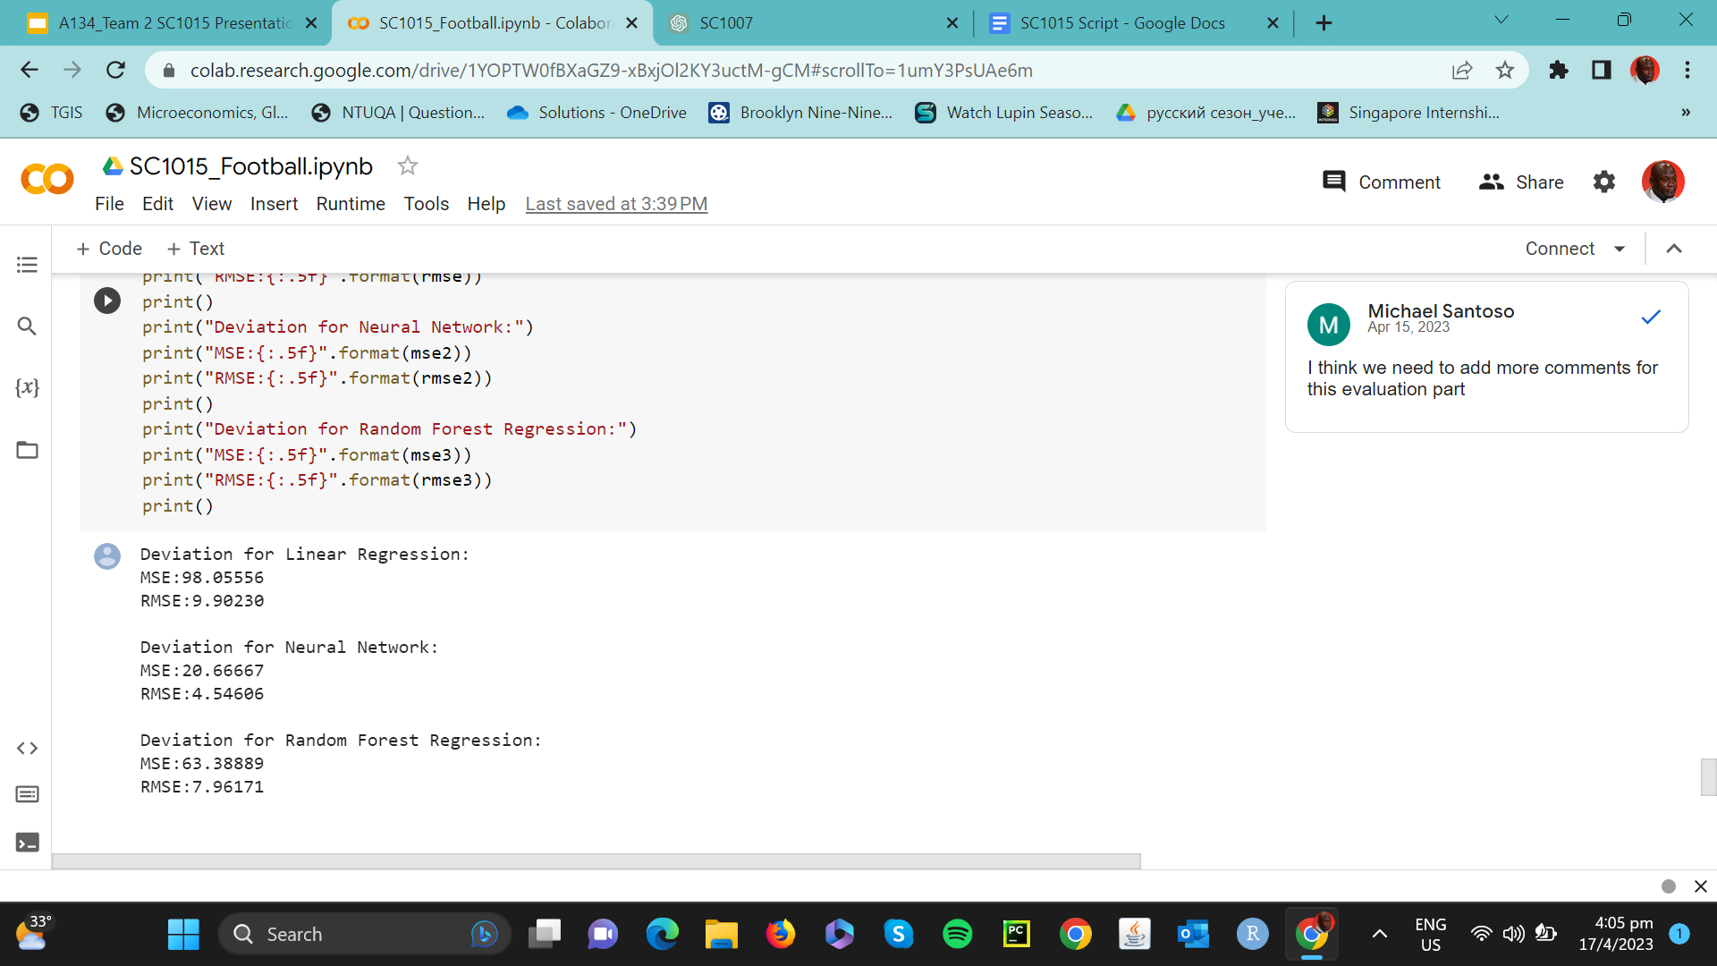
Actual
Predicted
Random Forest Regression
Results

Slide 39
04
OUTCOMES & INSIGHTS

Slide 40

ML Models Ranking
Linear Regression
GBMs, SVMs,
CNNs…
Random Forest Regression
Neural Network

Slide 41


Strength of Neural Network
Non linear relationships
Highly complex and non-linearity between predictors and responses
Generalization
neural networks can utilise regularization techniques
high data volume
overfitting

Slide 42
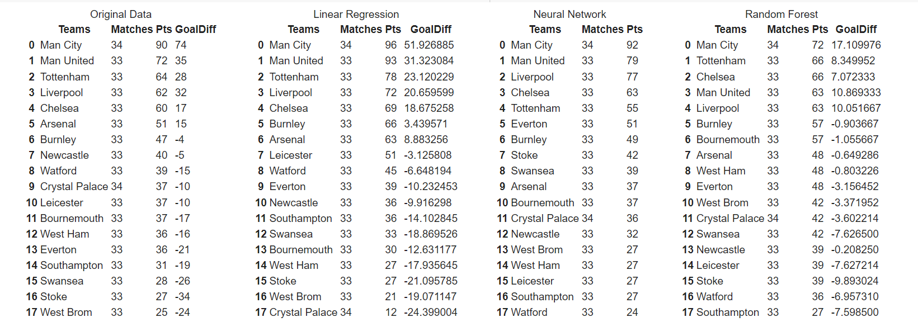
ML Models Ranking
Looking at the rankings across the 4 tables, we can conclude that in the top 6, there are always the usual 5 teams: Man City, Man United, Tottenham, Liverpool and Chelsea. The 6th team is more volatile.

Slide 43


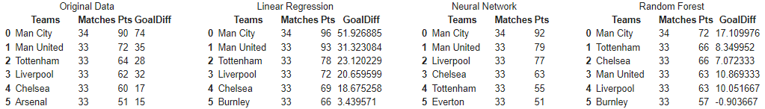


Conclusion
6 reliable variables are HTFormPts, ATFormPts, HTGD, ATGD, DiffPts, and DiffFormPts.
The 3 models use these variables to predict the ranking (Neural Network > Random Forest > Linear Regression)
Personal Objective: top 6 teams have higher likelihood

Slide 44
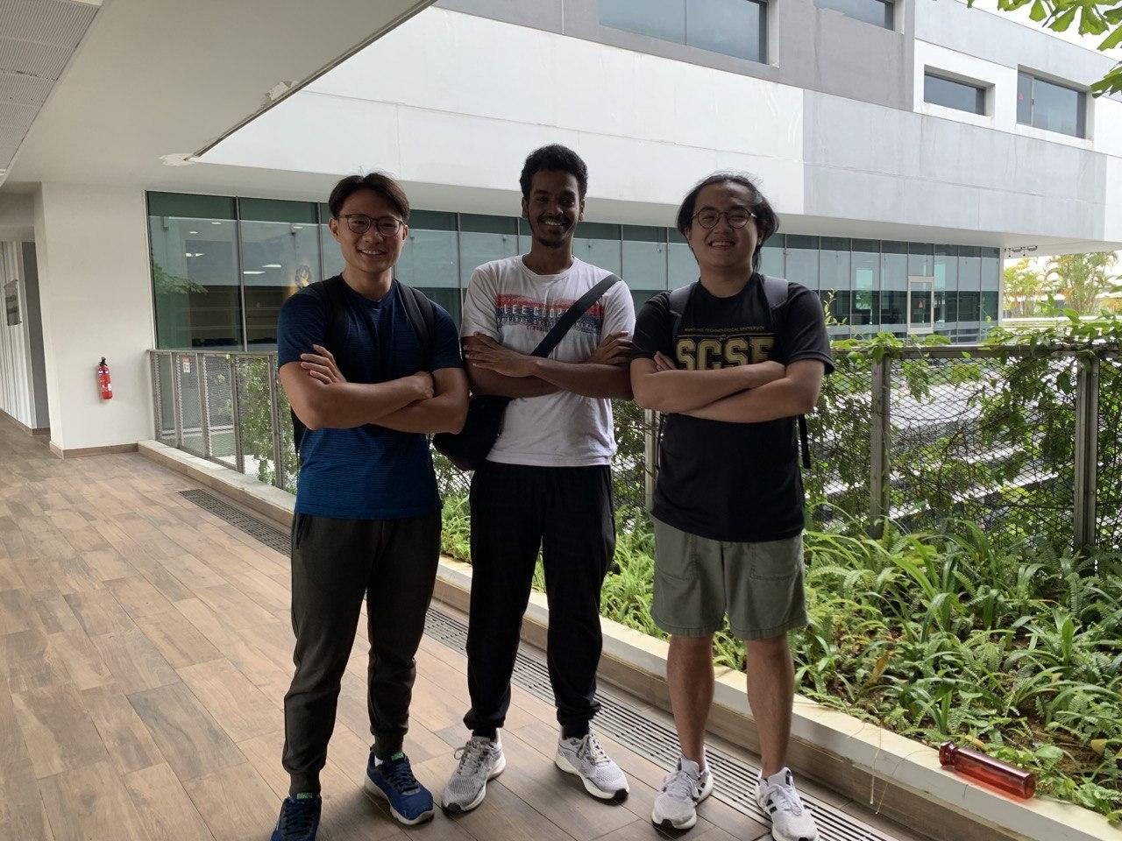
THANK YOU!

Slide 45
References
Brentford F.C. (n.d.). In Wikipedia. Retrieved February 15, 2023, from https://en.wikipedia.org/wiki/Brentford_F.C.
"Nottingham Forest F.C." Wikipedia. (n.d.). Retrieved February 15, 2023, from https://en.wikipedia.org/wiki/Nottingham_Forest_F.C.
Brighton & Hove Albion F.C. (2022, January 18). In Wikipedia. https://en.wikipedia.org/wiki/Brighton_%26_Hove_Albion_F.C.
"Huddersfield Town A.F.C." (2023, February 20). In Wikipedia. Retrieved February 21, 2023, from https://en.wikipedia.org/wiki/Huddersfield_Town_A.F.C.
"Manchester City F.C." Wikipedia. (n.d.). Retrieved February 15, 2023, from https://en.wikipedia.org/wiki/Manchester_City_F.C.
"Manchester United F.C." Wikipedia. (n.d.). Retrieved February 15, 2023, from https://en.wikipedia.org/wiki/Manchester_United_F.C.
Arsenal F.C. (n.d.). In Wikipedia. Retrieved February 15, 2023, from https://en.wikipedia.org/wiki/Arsenal_F.C.
"Chelsea F.C." Wikipedia. Wikimedia Foundation, Inc. Retrieved February 15, 2023, from https://en.wikipedia.org/wiki/Chelsea_F.C.
Bhavesh Bhatt. (2018, November 12). Linear Regression using Python. Towards Data Science. Retrieved from https://towardsdatascience.com/linear-regression-using-python-b136c91bf0a2.
Brown, J. (2019, January 5). Applied Deep Learning - Part 1: Artificial Neural Networks. Towards Data Science. https://towardsdatascience.com/applied-deep-learning-part-1-artificial-neural-networks-d7834f67a4f6
Sandeep, R. (2019, April 18). Random forest regression. Medium. https://levelup.gitconnected.com/random-forest-regression-209c0f354c84
"Liverpool F.C." Wikipedia. Wikimedia Foundation, Inc. Retrieved February 15, 2023, from https://en.wikipedia.org/wiki/Liverpool_F.C.

